Slide 1
UNIT – V Parallel Databases
Mr. S. L. Dhende
Notes:
1

Slide 2
Multi-user DBMS Architectures
The common architectures that are used to implement multi-user database management systems:
Teleprocessing
File-Server
Client-Server
Notes:
2

Slide 3
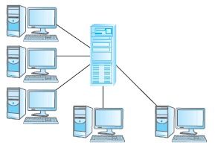
Teleprocessing
One computer with a single CPU and a number of terminals.
Processing performed within the same physical computer. User terminals are typically “dumb”, incapable of functioning on their own, and cabled to the central computer.
Notes:
3

Slide 4
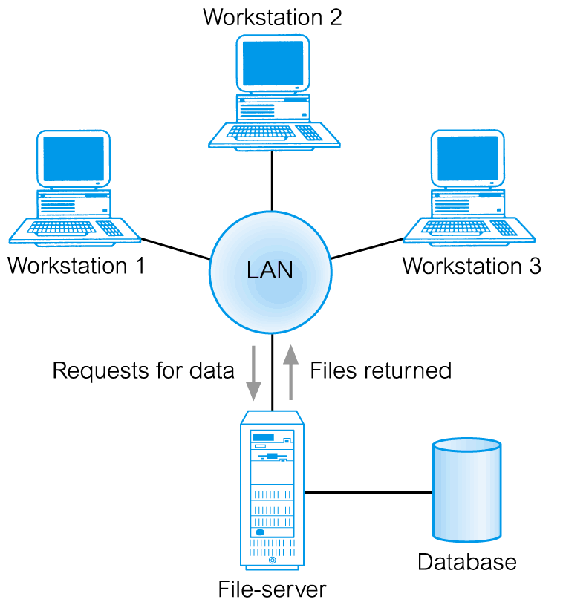
File-Server Architecture
In a file-server environment, the processing is distributed about the network, typically a local area network (LAN).
Notes:
4

Slide 5
File-Server Architecture
The file server holds the files required by the application and the DBMS. However, the applications and DBMS run on each workstation, requesting files from the file server when necessary.
The file server acts simply as a shared data disk. The DBMS on each workstation sends requests to the file server for all data that the DBMS requires that it is stored on disk.
The file server architecture has three main disadvantages :
There is a large amount of network traffic.
A full copy of DBMS is required on each workstation.
Concurrency, Recovery and Integrity control are more complex because there can be multiple DBMS accessing the same files.
Notes:
5

Slide 6
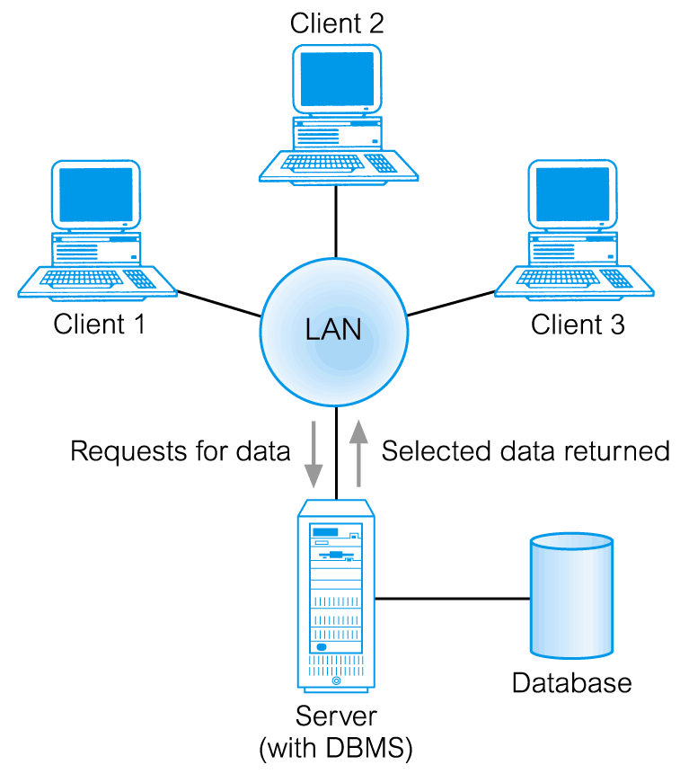
Client Server
To overcome the disadvantages of the first two methods the client-server architecture was developed. As the name suggests there is :
A client process, which requires some resource,
A server process, which provides the resource.
Fig. Traditional Two-Tier Client-Server
Notes:
6

Slide 7
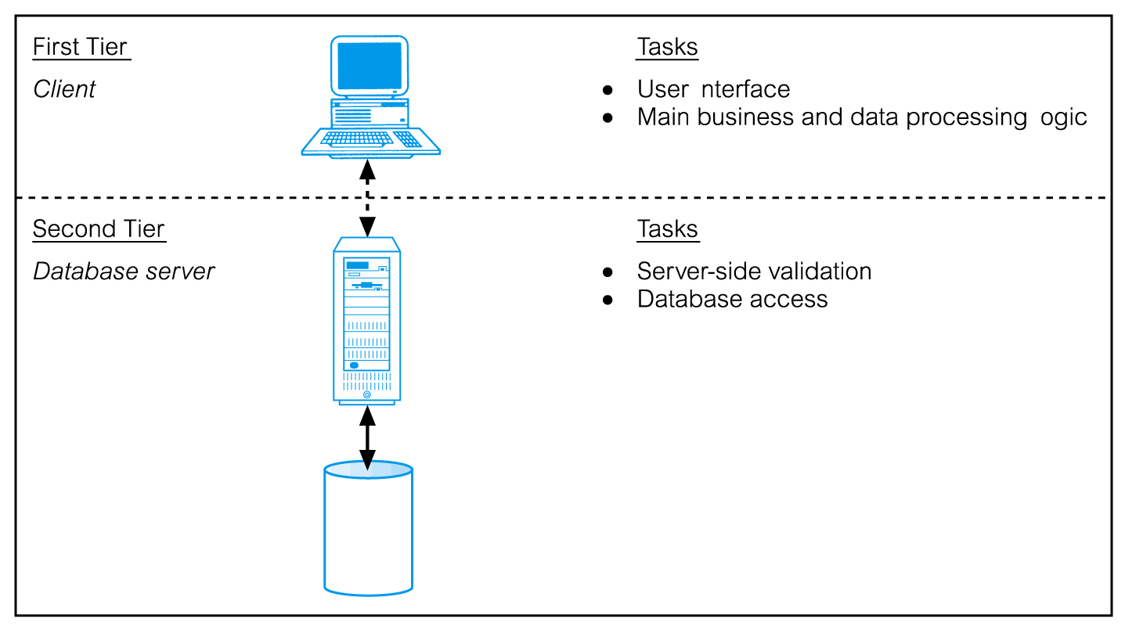
Traditional Two-Tier Client-Server
Notes:
7

Slide 8
Traditional Two-Tier Client-Server
Client process (tier 1) : There is no requirement that the client and server must reside on the same machine. In the database context, the client manages the user interface and the application logic.
It takes the user requests.
Accepts and checks syntax of user input
Generates database requests in SQL or another database language.
Transmits the message to the server, waits for response and formats the response for the end-user.
Server process (tier2):
Accepts and processes database requests from clients.
Checks authorization.
Ensures integrity constraints not violated.
Performs query/update processing and transmits response to the client.
Maintains system catalogue.
Provides concurrent database access.
Provides recovery control.
Notes:
8

Slide 9
Client Server
Advantages of Client-Server Architecture:
It enables wider access to existing databases.
Increased Performance : If the clients and the server reside on different computers then different computers can be processing application in parallel.
Hardware Costs may be Reduced : It is the only server that requires the storage and processing sufficient to store and manage the database.
Communication Costs are Reduced : Applications carry out part of operations on the client and send only the requests for database access over the network.
Increased Consistency : The server can handle integrity checks, so that constraints need be defined and validated only in one place.
It Maps on to Open : System architecture quite naturally.
Notes:
9

Slide 10
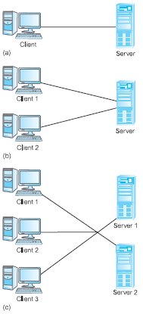
Alternative client server topologies
Fig. 1 Single Client, Single Server.
Fig. 2 Multiple Client, Single Server.
Fig. 3 Multiple Client, Multiple Server.
Notes:
10

Slide 11
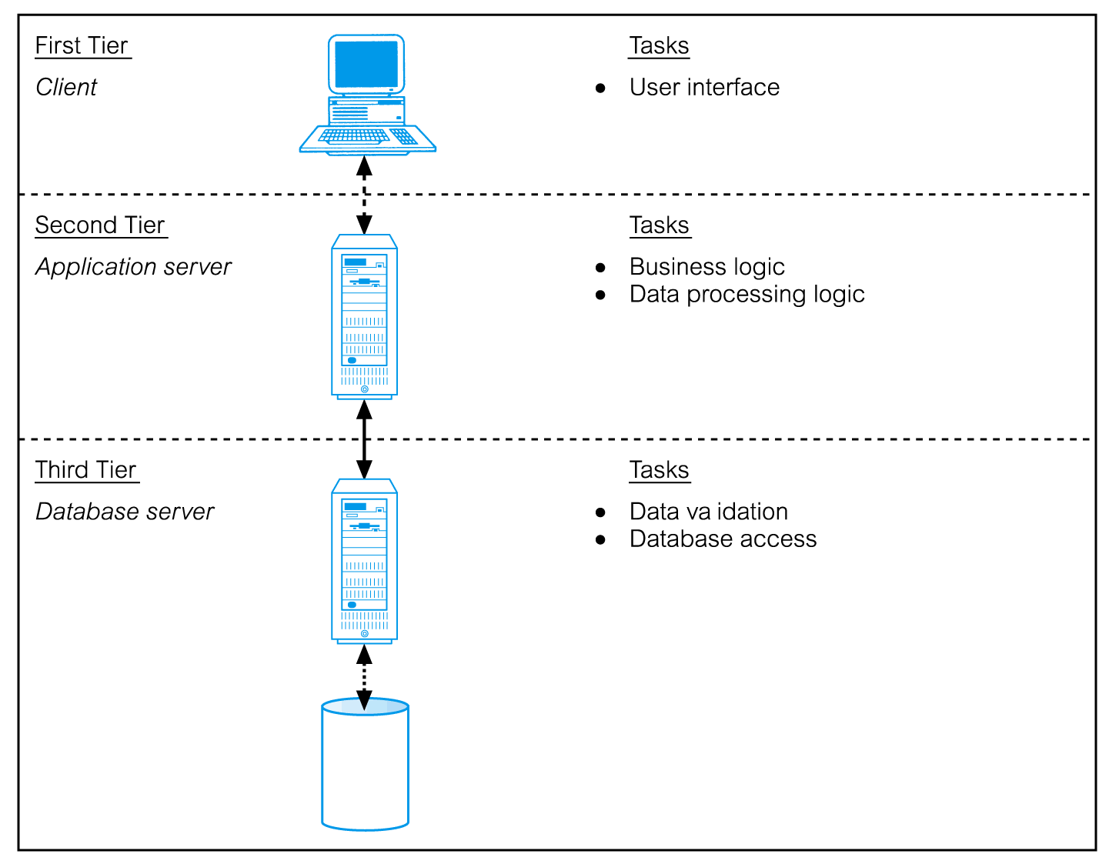
Three-Tier Client-Server
Notes:
11

Slide 12
Three-Tier Client-Server
The need for enterprise scalability challenged the traditional two-tier client–server model.
Client side presented two problems preventing true scalability:
‘Fat’ client, requiring considerable resources on client’s computer to run effectively.
Significant client side administration overhead.
By 1995, three layers proposed, each potentially running on a different platform.
Notes:
12

Slide 13
Three-Tier Client-Server
Advantages:
‘Thin’ client, requiring less expensive hardware.
Application maintenance centralized.
Easier to modify or replace one tier without affecting others.
Separating business logic from database functions makes it easier to implement load balancing.
Maps quite naturally to Web environment.
Notes:
13

Slide 14
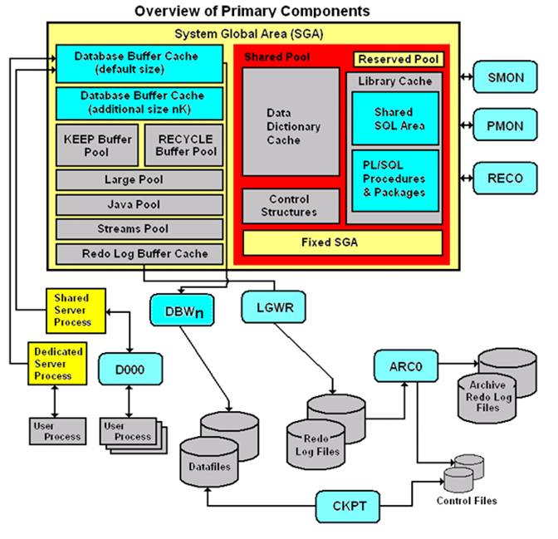
Oracle Architecture
Fig. Oracle architecture
Notes:
14

Slide 15
Oracle Architecture
SGA:
The System Global Area (SGA) is a group of shared memory structures, known as SGA components, that contain data and control information for one Oracle Database instance. The SGA is shared by all server and background processes. Examples of data stored in the SGA include cached data blocks and shared SQL areas.
Notes:
15

Slide 16
Oracle Architecture
Oracle server:
An Oracle server includes an Oracle Instance and an Oracle database.
An Oracle database includes several different types of files: datafiles, control files, redo log files and archive redo log files. The Oracle server also accesses parameter files and password files.
This set of files has several purposes.
One is to enable system users to process SQL statements.
Another is to improve system performance.
Still another is to ensure the database can be recovered if there is a software/hardware failure.
The database server must manage large amounts of data in a multi-user environment.
The server must manage concurrent access to the same data.
The server must deliver high performance. This generally means fast response times.
Notes:
16

Slide 17
Oracle Architecture
Oracle instance: An Oracle Instance consists of two different sets of components:
The first component set is the set of background processes (PMON, SMON, RECO, DBW0, LGWR, CKPT, D000 and others).
These are the background processes in a computer program.
These processes perform input/output and monitor other Oracle processes to provide good performance and database reliability.
The second component set includes the memory structures that comprise the Oracle instance.
When an instance starts up, a memory structure called the System Global Area (SGA) is allocated.
At this point the background processes also start.
An Oracle Instance provides access to one and only one Oracle database.
Notes:
17

Slide 18
Oracle Architecture
Oracle database: An Oracle database consists of files.
Sometimes these are referred to as operating system files, but they are actually database files that store the database information that a firm or organization needs in order to operate.
The redo log files are used to recover the database in the event of application program failures, instance failures and other minor failures.
The archived redo log files are used to recover the database if a disk fails.
Other files not shown in the figure include:
The required parameter file that is used to specify parameters for configuring an Oracle instance when it starts up.
The optional password file authenticates special users of the database – these are termed privileged users and include database administrators.
Alert and Trace Log Files – these files store information about errors and actions taken that affect the configuration of the database.
Notes:
18

Slide 19
Oracle Architecture
User and server processes: The processes shown in the figure are called user and server processes. These processes are used to manage the execution of SQL statements.
A Shared Server Process can share memory and variable processing for multiple user processes.
A Dedicated Server Process manages memory and variables for a single user process.
Notes:
19

Slide 20
Parallel Databases
Parallel database systems consist of multiple processors and multiple disks connected by a fast interconnection network.
A coarse-grain parallel machine consists of a small number of powerful processors
A massively parallel or fine grain parallel machine utilizes thousands of smaller processors.
Two main performance measures:
throughput --- the number of tasks that can be completed in a given time interval
response time --- the amount of time it takes to complete a single task from the time it is submitted
Notes:
20

Slide 21
Speed-Up and Scale-Up
Speedup: The ability to execute the tasks in less time by increasing the number of resources is called Speedup.
Measured by:
speedup = time original
time parallel
Where ,
time original = time required to execute the task using 1 processor
time parallel = time required to execute the task using 'n' processors
Speedup is linear if equation equals N.
Notes:
21

Slide 22
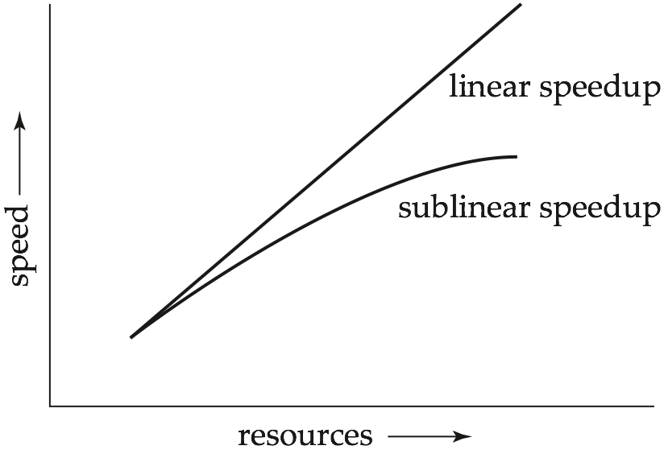
Speedup
Notes:
22

Slide 23
Speed-Up and Scale-Up
Scaleup: The ability to maintain the performance of the system when both workload and resources increase proportionally.
Scaleup = Volume Parallel / Volume Original
Where ,
Volume Parallel = volume executed in a given amount of time using 'n' processor
Volume Original = volume executed in a given amount of time using 1 processor
Scale up is linear if equation equals 1.
Notes:
23

Slide 24
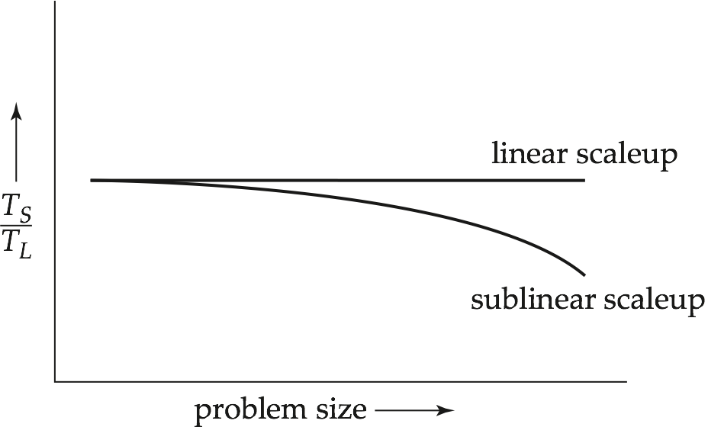
Scaleup
Notes:
24

Slide 25
Interconnection Network Architectures
Bus. System components send data on and receive data from a single communication bus;
Does not scale well with increasing parallelism.
Mesh. Components are arranged as nodes in a grid, and each component is connected to all adjacent components
Communication links grow with growing number of components, and so scales better.
But may require 2√n hops to send message to a node (or √n with wraparound connections at edge of grid).
Hypercube. Components are numbered in binary; components are connected to one another if their binary representations differ in exactly one bit.
n components are connected to log(n) other components and can reach each other via at most log(n) links; reduces communication delays.
Notes:
25

Slide 26
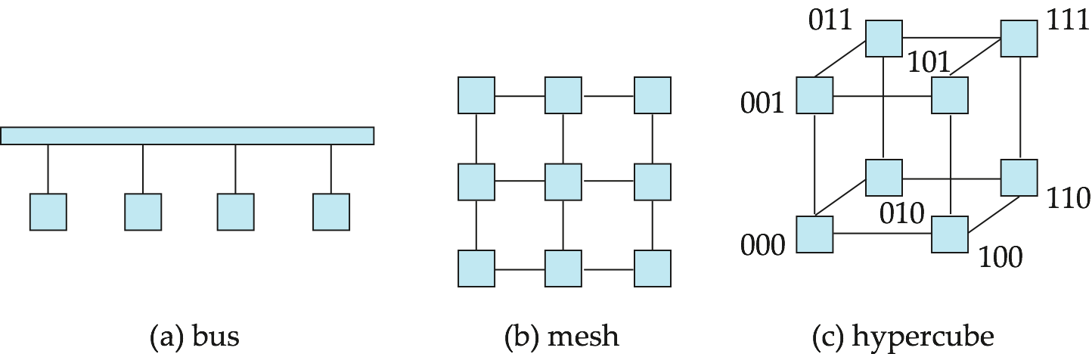
Interconnection Architectures
Notes:
26

Slide 27
Parallel Database Architectures
Shared memory -- processors share a common memory
Shared disk -- processors share a common disk
Shared nothing -- processors share neither a common memory nor common disk
Hierarchical -- hybrid of the above architectures
Notes:
27

Slide 28
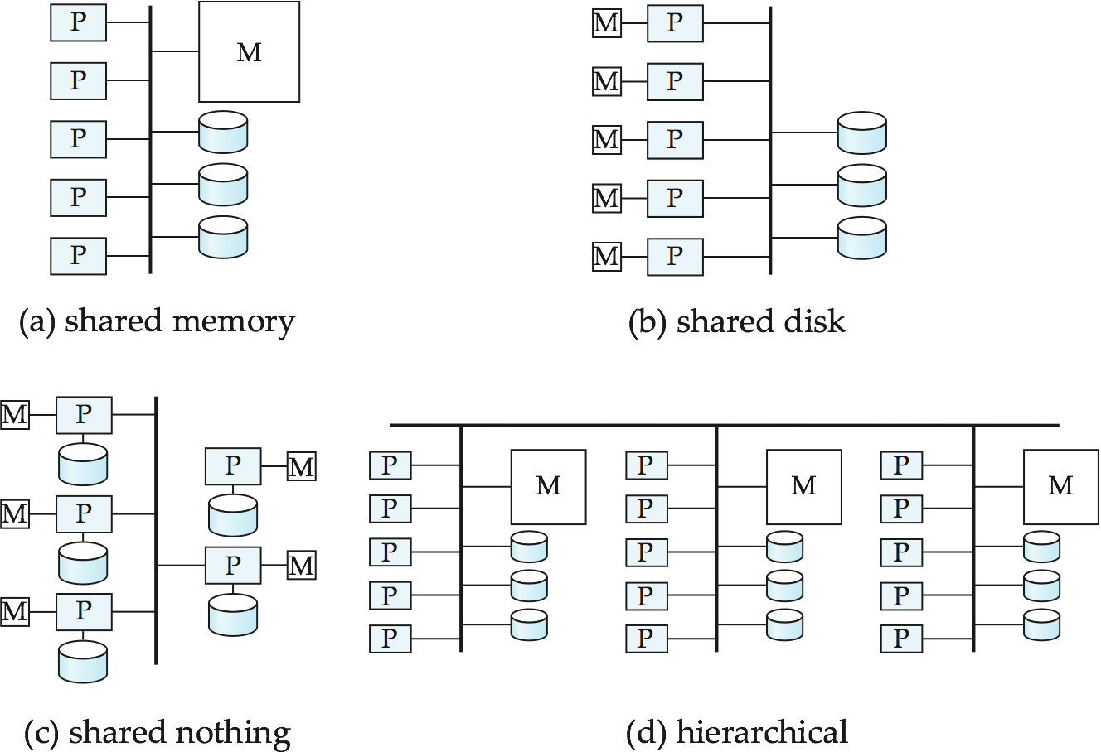
Parallel Database Architectures
Notes:
28

Slide 29
Shared Memory
Processors and disks have access to a common memory, typically via a bus or through an interconnection network.
Extremely efficient communication between processors — data in shared memory can be accessed by any processor without having to move it using software.
Downside – architecture is not scalable beyond 32 or 64 processors since the bus or the interconnection network becomes a bottleneck
Widely used for lower degrees of parallelism (4 to 8).
Notes:
29

Slide 30
Shared Disk
All processors can directly access all disks via an interconnection network, but the processors have private memories.
The memory bus is not a bottleneck
Architecture provides a degree of fault-tolerance — if a processor fails, the other processors can take over its tasks since the database is resident on disks that are accessible from all processors.
Examples: IBM Sysplex and DEC clusters (now part of Compaq) running Rdb (now Oracle Rdb) were early commercial users
Downside: bottleneck now occurs at interconnection to the disk subsystem.
Shared-disk systems can scale to a somewhat larger number of processors, but communication between processors is slower.
Notes:
30

Slide 31
Shared Nothing
Node consists of a processor, memory, and one or more disks. Processors at one node communicate with another processor at another node using an interconnection network. A node functions as the server for the data on the disk or disks the node owns.
Examples: Teradata, Tandem, Oracle-n CUBE
Data accessed from local disks (and local memory accesses) do not pass through interconnection network, thereby minimizing the interference of resource sharing.
Shared-nothing multiprocessors can be scaled up to thousands of processors without interference.
Main drawback: cost of communication and non-local disk access; sending data involves software interaction at both ends.
Notes:
31

Slide 32
Hierarchical
Combines characteristics of shared-memory, shared-disk, and shared-nothing architectures.
Top level is a shared-nothing architecture – nodes connected by an interconnection network, and do not share disks or memory with each other.
Each node of the system could be a shared-memory system with a few processors.
Alternatively, each node could be a shared-disk system, and each of the systems sharing a set of disks could be a shared-memory system.
Reduce the complexity of programming such systems by distributed virtual-memory architectures
Also called non-uniform memory architecture (NUMA)
Notes:
32

Slide 33
Evaluating Parallel Query in Parallel Databases
The two techniques used in query evaluation are as follows:
Inter query parallelism
This technique allows to run multiple queries on different processors simultaneously.
Pipelined parallelism is achieved by using inter query parallelism, which improves the output of the system.
For example: If there are 6 queries, each query will take 3 seconds for evaluation. Thus, the total time taken to complete evaluation process is 18 seconds. Inter query parallelism achieves this task only in 3 seconds. However, Inter query parallelism is difficult to achieve every time.
Notes:
33

Slide 34
Evaluating Parallel Query in Parallel Databases contd.
Intra Query Parallelism
In this technique query is divided in sub queries which can run simultaneously on different processors, this will minimize the query evaluation time.
Intra query parallelism improves the response time of the system.
For Example: If we have 6 queries, which can take 3 seconds to complete the evaluation process, the total time to complete the evaluation process is 18 seconds. But We can achieve this task in only 3 seconds by using intra query evaluation as each query is divided in sub-queries.
Notes:
34

Slide 35
Virtualization on Multicore processors
Multicore processing and virtualization are rapidly becoming ubiquitous in software development. They are widely used in the commercial world, especially in large data centers supporting cloud-based computing, to
(1) isolate application software from hardware and operating systems,
(2) decrease hardware costs by enabling different applications to share underutilized computers or processors,
(3) improve reliability and robustness by limiting fault and failure propagation and support failover and recovery, and
(4) enhance scalability and responsiveness through the use of actual and virtual concurrency in architectures, designs, and implementation languages.
Notes:
35

